Slide 1
Nerve cells and glia

Slide 2
10-50 times more glia than neurons in humans
Glia not involved in information processing
Functions:
- Myelin used to insulate axons and conduct nerve impulses
-scavengers
- House-keeping (take up transmitters, excess K⁺)
Radial glia—aid neuronal migration in development
Astrocytes form blood-brain barrier
Provide structure, insulate neuron groups, synapses
At NMJ, modulate properties of the presynaptic terminal
Notes:
Glia is Greek for glue.
About 10¹¹ neurons in the human brain.
10,000 different types of neurons, but they all share common features.
Neurons with basically similar properties are able to produce very different actions because of precise connections with each other and with sensory receptors and muscle.
In lower animals, the ratio of astrocytes to neurons is smaller in the cortex. In rodents, the ratio is reversed. There are ~10 neurons for every astrocyte in rodent cortex.

Slide 3
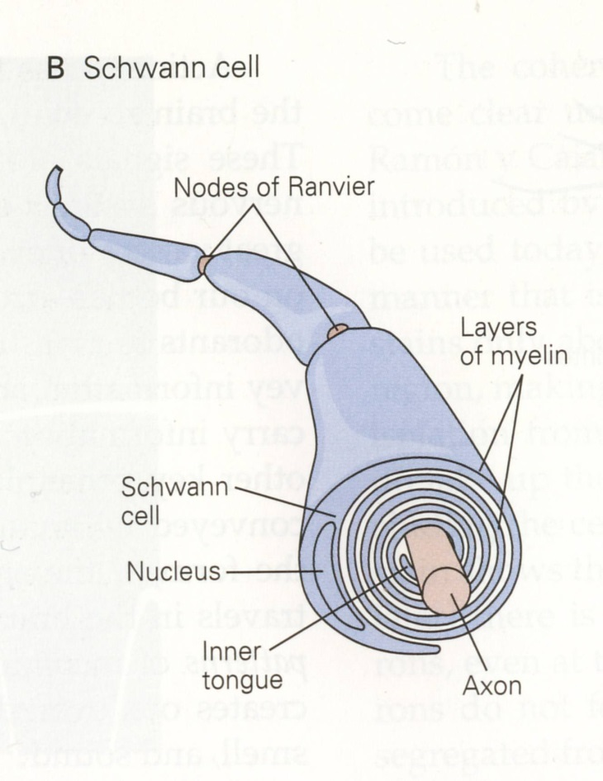
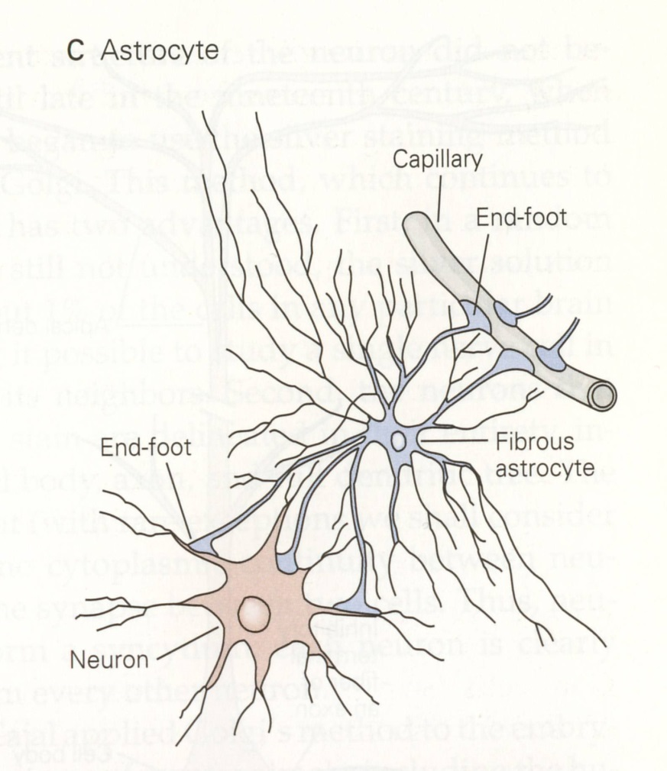
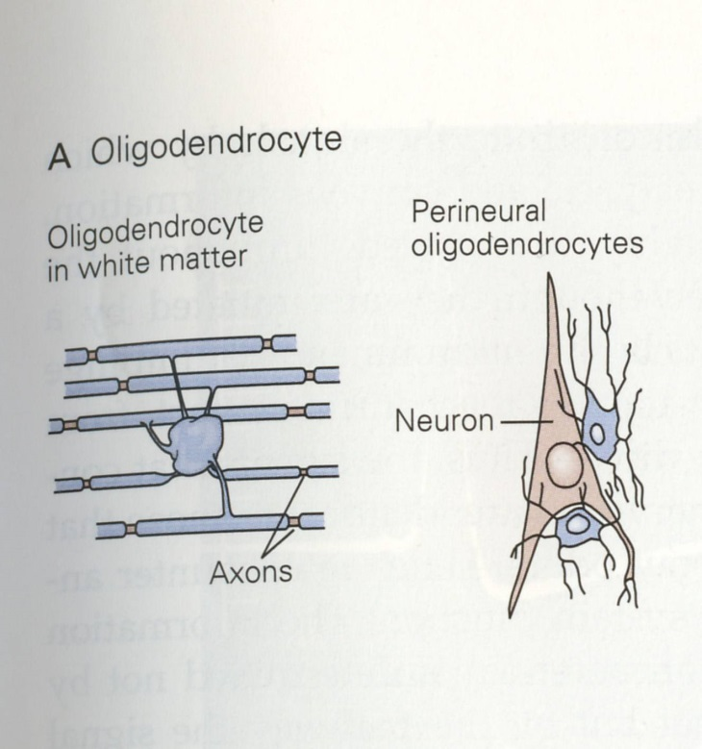
Principal types of glia in CNS, PNS
Peripheral nervous system
Central nervous system

Slide 4
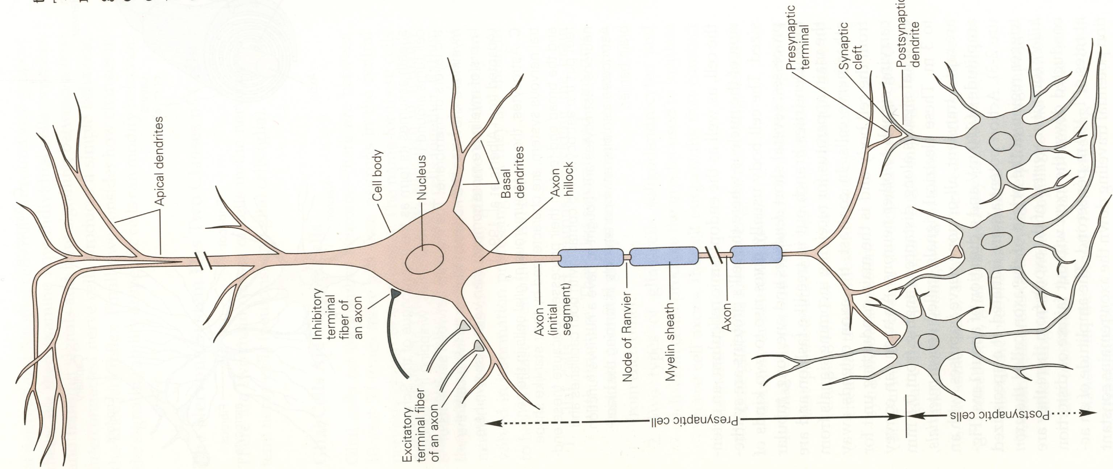
The neuron
Notes:
Cell body contains nucleus, which stores the DNA, ER where cell’s proteins are synthesized
Axons: output (longer than dendrite, can be 0.1 mm – 3 m). Usually the biggest neurite in the cell. It is capable of conveying information great distances by propagating in an all-or-none way a transient electrical signal called the action potential.
Dendrites :input. Potentials are typically graded, however in the big pyramidal cells, there may be action potentials just like in the axon!!
Synapses: The axon divides into fine branches towards the end and forms communication sites with other cells called synapses.Most synapses in the brain are axodendritic, i.e. between a presynaptic axon and a postsynaptic dendrite. There are also axoaxonic synapses and even dendrodendritic synapses as well, but they form a small minority of all synapses.
Synapse: the point at which two neurons communicate.
Presynaptic cell: transmits signal
Postsynaptic cell: receives signal.
Synaptic cleft: The space separating the pre- from the post-synaptic cell. It communicates with the extra-cellular space. There is no cytoplasmic continuity between cells at the synapse.
Axon hillock: region of neuron when axon begins and the action potential is initiated after a critical threshold is reached.
Pyramidal cells have two types of dendrites: long, slender apical dendrites that emerge for the apex of the cell body and shorter, stubbier basal dendrites that emerge from the base.

Slide 5
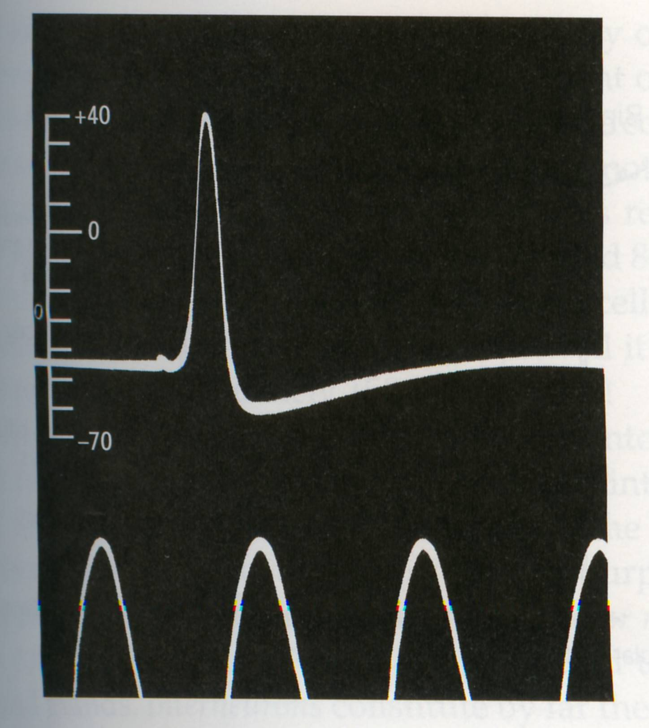
The action potential
Notes:
First published intracellular recording of an action potential or AP (Hodgkin and Huxley, 1939) from a squid giant axon.
APs are all-or-none impulses of amplitude 70-100 mV, and a duration of 1 ms.
Amplitude and duration of AP remains the same, the firing rate (number of action potentials or spikes) varies with stimulus intensity
Action potentials constitute the signals by which the brain receives, analyzes and conveys information.
Amplitude of AP remains constant because it is regenerated at regular intervals along the axon.
The information conveyed by an AP is not determined by the form of the signal (very stereotyped), but by the pathway the signals travels in the brain and properties of the neural code, such as frequency of the spikes, timing, correlations with spikes from other neurons etc.
Nodes of Ranvier: myelin is interrupted. AP regenerated at these spots. Insulation causes the signal to travel faster through the axon with very little dissipation.

Slide 6
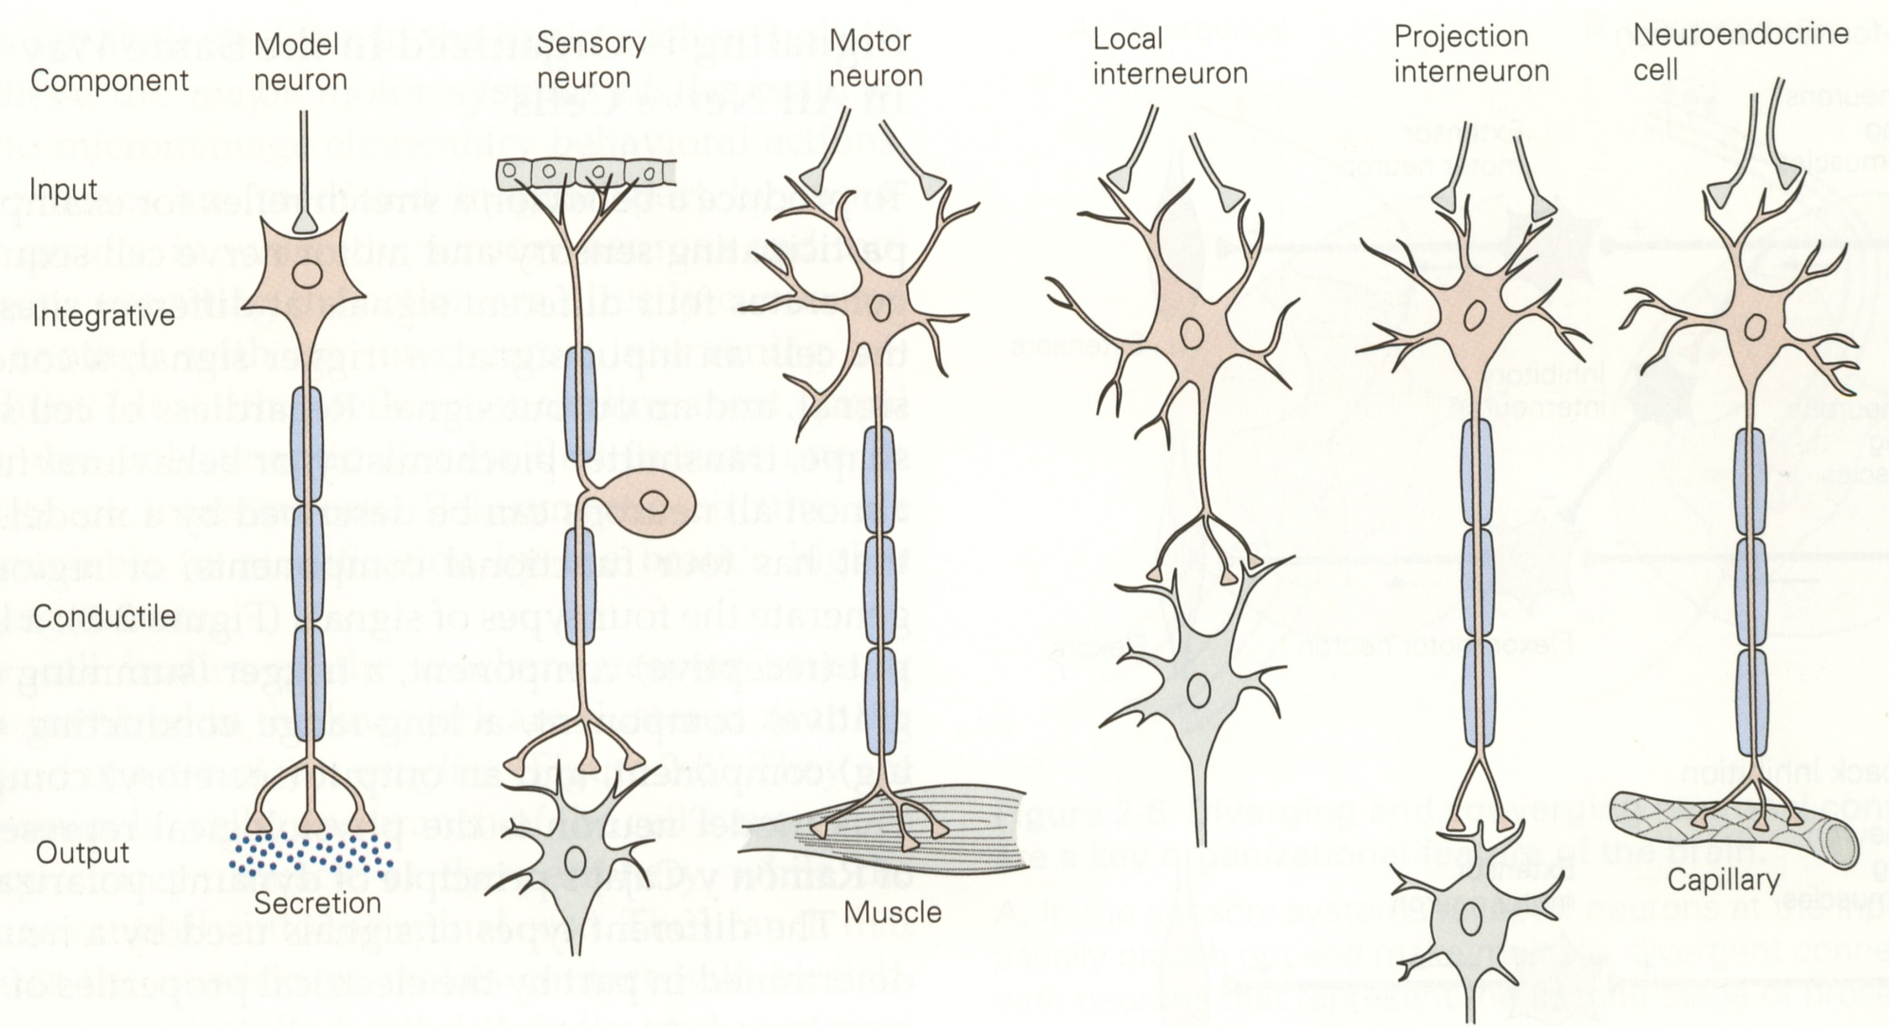
Four functional regions of a neuron
1. Input
2. Integrative
3. Conductile
4. Output
Notes:
Distinguishing property of neurons is shape, specifically the number and form of a neuron’s processes.
Most neurons (bipolar, multipolar, sensory, motor, interneuron), regardless of type have four components or functional regions.
There are exceptions: The local interneuron does not have a conductile component. Local cells do not need long axons.

Slide 7
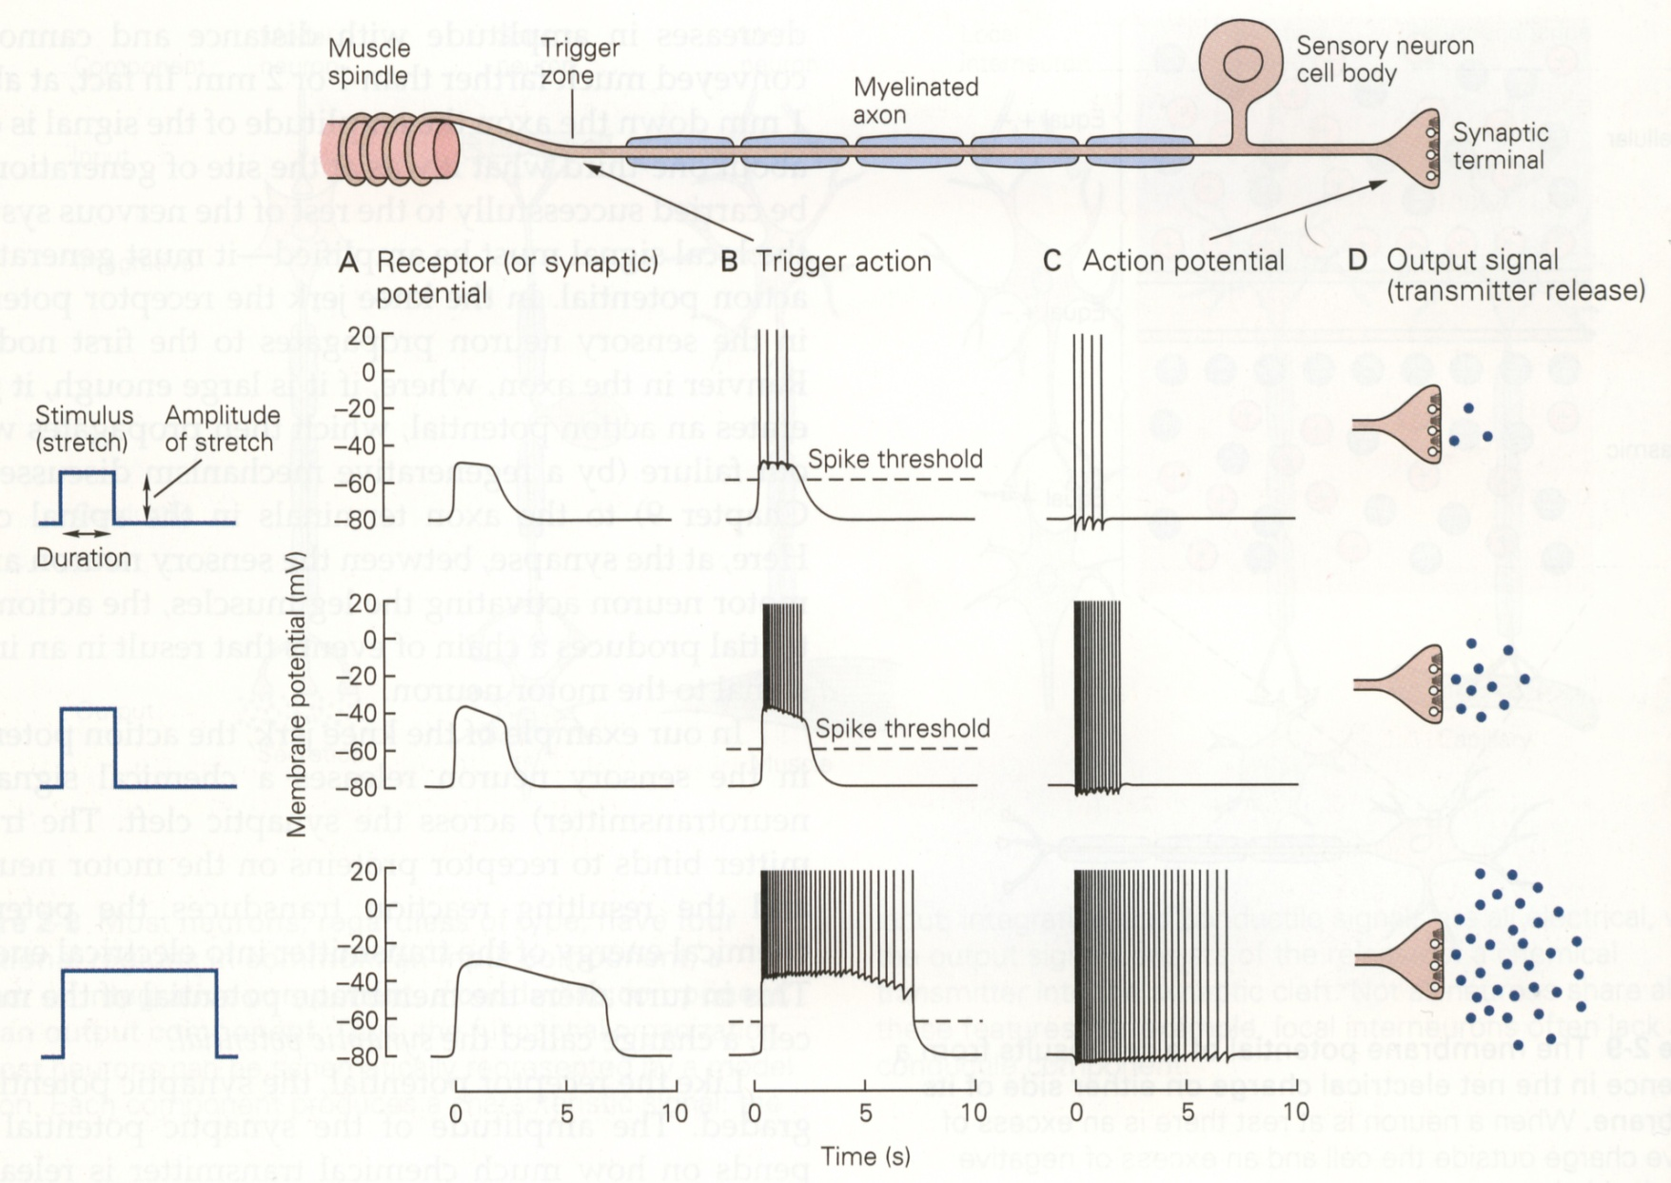
How the four neuronal
components respond
Notes:
The input signal (receptor or synaptic potential) is graded in amplitude and duration, proportional to amplitude and duration of the stimulus.
The trigger zone integrates the input signal, which if it crosses threshold, generates a spike or AP that propagates down the axon. Any suprathreshold increase in amplitude of the input signal increases the frequency of the APs—or firing rate of the neuron. Thus, the graded nature of the input signal is translated into a frequency code of APs.
APs are all-or-none. Information is coded by the frequency/number of spikes and possibly, their relative timing—relative to the stimulus and to each other, not by the amplitude or duration of the AP, which are more or less fixed. Thus, between the input→integrative components, an ADC takes place. Because, the conversion involves quantization of the input, it necessarily introduces a small amount of error. Instead of doing a single conversion, an ADC often performs the conversions (samples the input) periodically. The result is a sequence of digital values that have converted a continuous-time and continuous-amplitude analog signal to a discrete time and discrete-amplitude digital signal. Note that If an ADC operates at a sampling rate greater than twice the bandwidth of the signal, i.e, the Nyquist frequency, then a theoretically perfect reconstruction is possible given an ideal ADC and neglecting quantization error. But typically, one needs 10X the bandwidth for practically perfect reconstruction. There is loss of information in the neuron here. But, the tradeoff is the ability for the signal to travel over longer distances, i.e. along the axon.
Transmitting electricity at high voltage reduces the fraction of energy lost to resistance. For a given amount of power, a higher voltage reduces the current and thus the resistive losses in the conductor. This is the principle in power transmission and is the same principle applied to electrical transmission in neurons. This is what the AP does. The voltage of an AP is higher than that of a synaptic potential, allowing the information to be transmitted over longer distances (sometimes order of meters)
When AP reaches synaptic terminal, the cell releases a chemical transmitter that serves as the output signal. The total number of spikes determines the amount of transmitter released. Transmitter release is not an analog variable but is quantized.

Slide 8
Principle of dynamic polarization
Electrical signals in a cell flow in one direction:
dendrites → trigger zone of the axon.

Slide 9
Principle of connectional specificity
Nerve cells do not form random networks.
Each cell makes specific connections with certain postsynaptic cells but not others.

Slide 10
Types of neurons
Morphology
Function
Unipolar
Bipolar
Multipolar
Sensory
Motor
Interneuron
Projection
Local

Slide 11
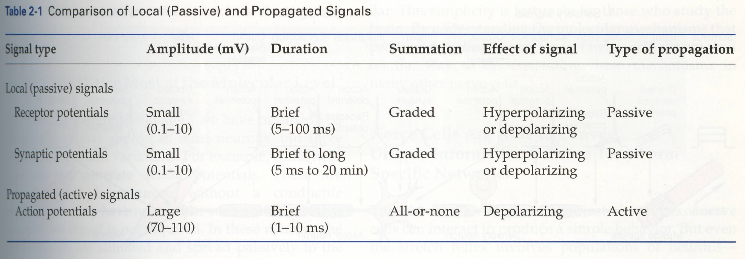
Comparison of local (passive) and active signals

Slide 12
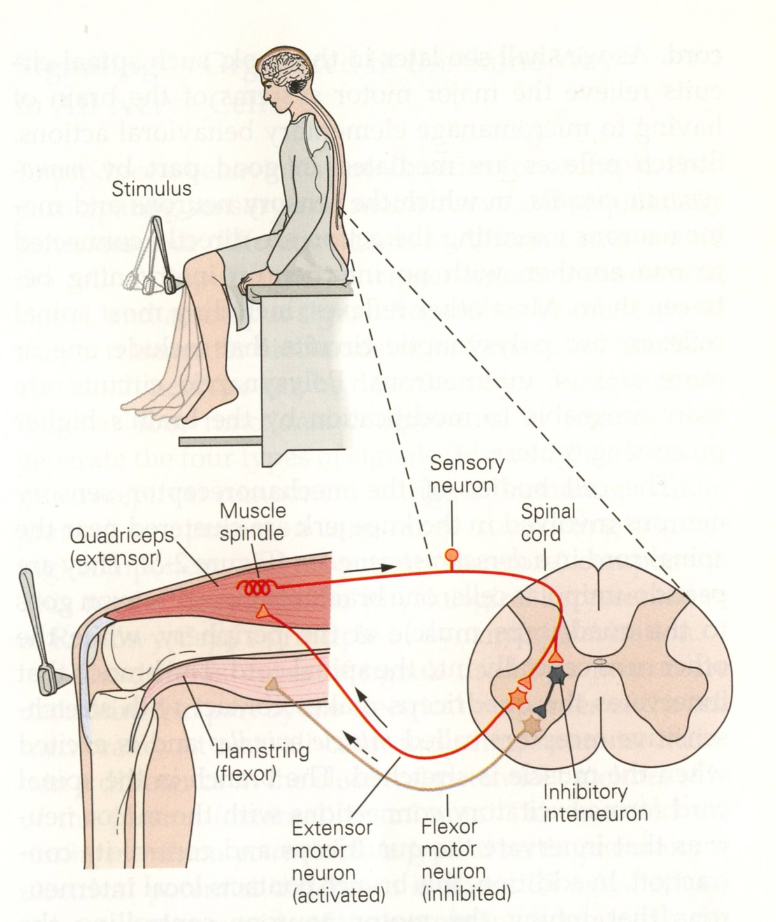
A monosynaptic reflex system

Slide 13
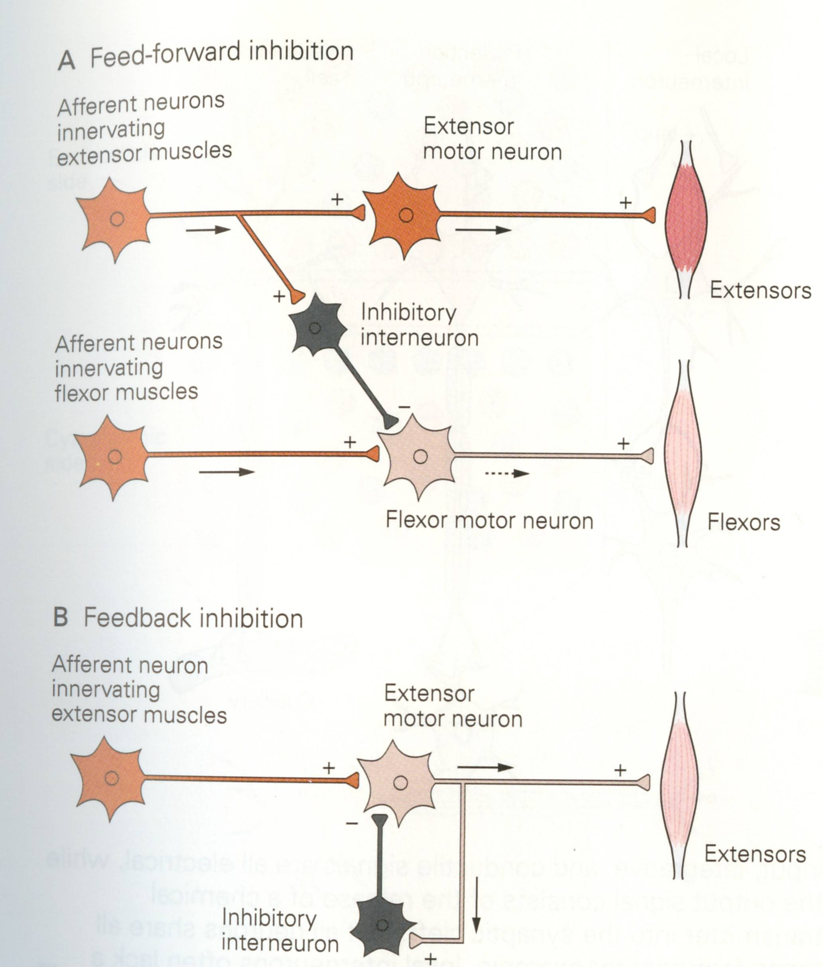
A simple
neural circuit
Notes:
One of the best understood microcircuits is the circuit that mediates simple reflex behaviors. This
illustrates the circuit for the so-called knee jerk or stretch reflex. A neurologist strikes the knee with a
rubber tapper, which elicits an extension of the leg. This test is used as a simple way to examine the
integrity of some of the sensory and motor pathways in the spinal cord. The tap of hammer stretches
the muscle and leads to the initiation of action potentials in sensory neurons within the muscle that are
sensitive to stretch. Let’s first discuss the branch to the left that forms a synaptic connection with an
Extensor motor neuron. The action potential in the sensory neuron invades the synaptic terminal of the
sensory neuron causing the release of transmitter and subsequent excitation of the motor neuron. The
stretch to the muscle leads to an action potential in the motor neuron, which then propagates out the
peripheral nerve to invade the synapse at the muscle, causing the release of transmitter and an action
potential in the muscle. The action potential in the muscle cell leads to a contraction of the muscle and
an extension of the limb. So, here we have a simple feedforward excitation circuit that mediates a
behavior.
Now let’s examine the right branch of the axon of the sensory neuron. The action potential in the
sensory neuron invades the synaptic terminal of the sensory neuron causing the release of transmitter,
and subsequent excitation of the postsynaptic interneuron colored black. This neuron is called an
interneuron because it is interposed between one neuron and another neuron. The excitation of the
interneuron leads to the initiation of an action and the subsequent release of transmitter from the
presynaptic terminal of the interneuron, but for this branch of the circuit, the transmitter leads to an
IPSP in the postsynaptic flexor motor neuron. The functional consequences of this feedforward inhibition it is to decrease the probability of the flexor motor neuron becoming active and producing an
inappropriate flexion of the leg.

Slide 14
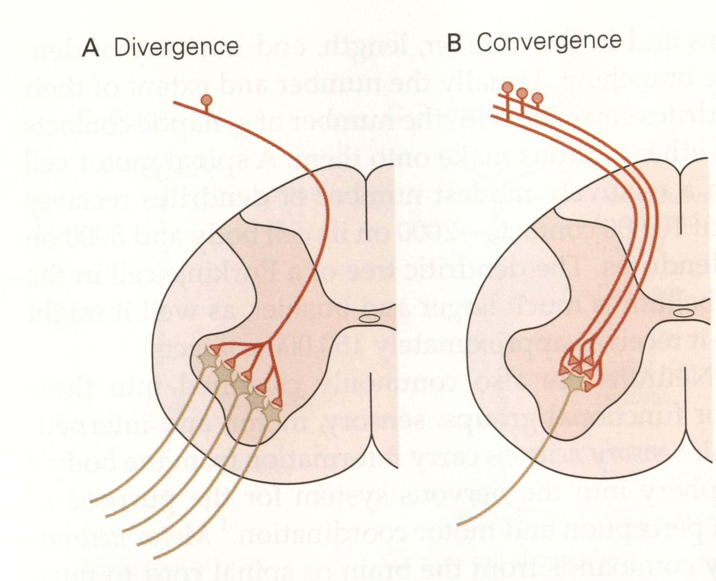
Converging and diverging
neuronal connections
Notes:
A single dorsal root ganglion cell makes connections with several motor neurons (divergence).
Several dorsal root ganglion cells make connections with a single motor neuron (convergence).

Slide 15
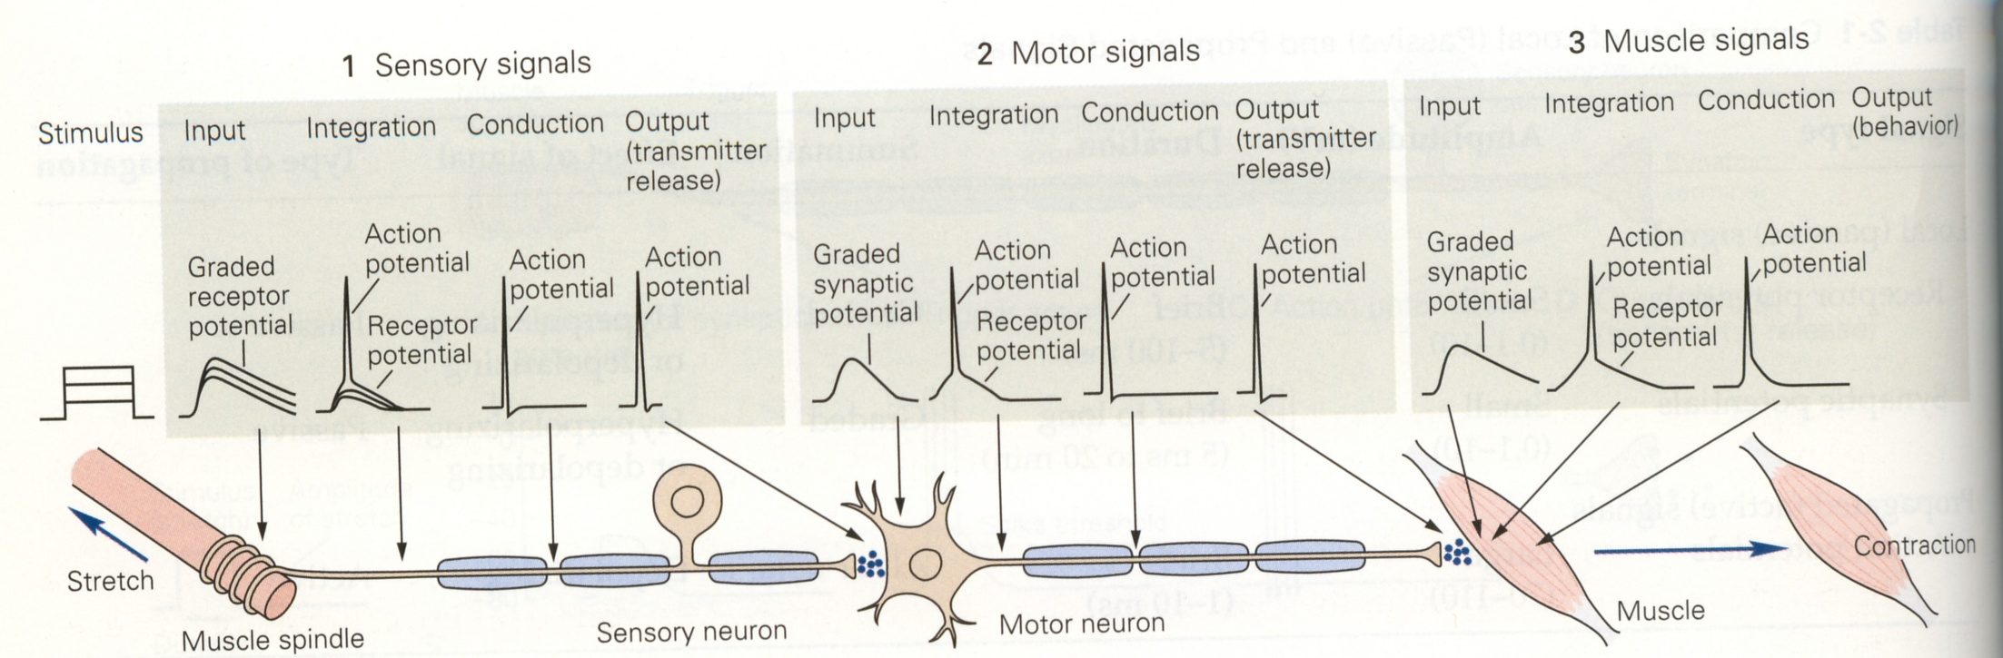
Reflex action: sequence of signals
Notes:
Stretching of muscle→Receptor potential (RP) in terminal fibers of DRG cell (sensory neuron). Amplitude varies with intensity of stretch→
RP spreads passively to trigger zone. If RP large, AP generated→
AP propagates actively with no loss→
At presynaptic terminal, chemical transmitter is released→
transmitter diffuses across synaptic cleft and interacts with receptor on postsynaptic membrane of motor neuron that innervate stretched muscle→
Synaptic potential generated in motor neuron→
Spreads passively to trigger zone→
Initiates an AP→
AP propagates to terminal of motor axon→
AP releases transmitter at NMJ synapse→
Transmitter binds to ACh receptors on muscle cell→
Synaptic potential triggered in muscle cell→
AP produced in muscle cell→
AP causes contraction of muscle fiber

Slide 16
What defines psychological function and behavior?
Synaptic view: The way the neurons connect with one another
Neuronal view: Intrinsic properties of individual neurons
Gestalt view: Large aggregates of neurons that act globally as a field or Gestalt
The synaptic view is the most dominant
In order for the intrinsic properties of neurons to be expressed
in psychological functions of the brain, it is necessary for that cell
to interact with others via synapses

Slide 17
We will focus on:
Membrane biophysics: The mechanisms by which
neurons produce signals.
b. Short-range, long-range connectivity: The patterns
of connections between nerve cells.
c. Brain-behavior correlates: The relationship of
different patterns of connectivity to different types of behavior.
d. Neural plasticity: The means by which neurons and their
connections are modified by experience and learning.

Slide 18
Review
Glia, their functions
Nerve cell—components
Cajal’s principles
Types of neurons
Reflex circuit

